Slide 1
High-Fat Diet–Induced Gut Dysbiosis Promotes Hepatic Lipid Accumulation via the Bile Acid–FXR Axis
PhD Dissertation Defense
Candidate Jane Doe Advisor Prof. Alex Smith
Program PhD, Nutritional Sciences School Example University
Committee A. Smith (chair), B. Jones, C. Patel, D. Garcia (external member)
Date September 2026
Notes:
This slide (under 30 seconds): thank the chair for the introduction, then give your name, program and the title. Many defenses open with the committee chair introducing you; keep your own opening short.
Tip: a long title can run to three lines, but keep it at 30 pt or larger. Click the icon at top left to insert your university logo.
SciDraw AI research templates · sci-draw.com · Example edition: the study, names and data are fictional and only show what to write on each slide.

Slide 2
Read this before you start editing
How to use · hidden in Slide Show
1 Replace the content
2 Insert figures
Everything is fictional; charts are marked "example data". Replace it slide by slide.
Click the icon in a frame to insert a picture. The link under a figure opens a ready-made prompt.
3 Edit the charts
4 Recolor everything
Charts are native PowerPoint charts: right-click → Edit Data and the chart updates.
Design → Variants → Colors recolors the whole deck at once. The font is Arial, on both Windows and Mac.
Timing A PhD defense talk usually runs 40–50 minutes (master's: 20–30), roughly 1.5–2 minutes per slide. This slide and the two backup slides at the end stay hidden in Slide Show.
UK viva The viva itself is usually a discussion of the thesis without slides. Use this deck for a public defense or exit seminar if your department holds one.
Notes:
This slide explains the template. It is hidden in Slide Show; delete it when you are done.
SciDraw AI research templates · sci-draw.com · Example edition: the study, names and data are fictional and only show what to write on each slide.

Slide 3
Outline
OUTLINE
01
Background & motivation
Why this question matters
The question this dissertation answers
Does high-fat-diet–induced gut dysbiosis promote fat build-up in the liver by reshaping bile acids and suppressing hepatic FXR signaling?
State this question clearly now; every chapter that follows comes back to it.
02
Aims & approach
What I asked and how I studied it
03
Results
Findings aim by aim
04
Contributions & conclusions
What is new, limitations, next steps
05
Publications
Papers and presentations
Notes:
This slide (20 seconds): walk through the structure, then read the question on the right aloud. It is the thread through the whole talk.
SciDraw AI research templates · sci-draw.com · Example edition: the study, names and data are fictional and only show what to write on each slide.

Slide 4
Background & Motivation
01
Why this question matters: the health problem, what we know, and the missing link
Notes:
This slide: a transition. Pause for 3–5 seconds and say "Let me start with the background."
SciDraw AI research templates · sci-draw.com · Example edition: the study, names and data are fictional and only show what to write on each slide.

Slide 5
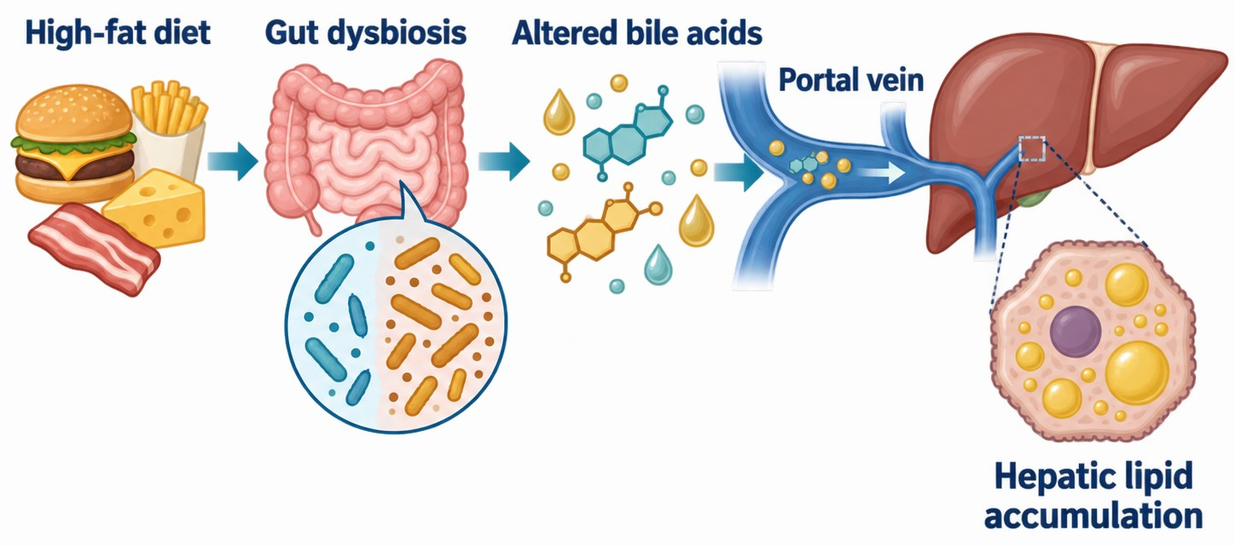
The gut–liver axis: from high-fat diet to fatty liver
01 Background & motivation
The problem
MASLD, the most common chronic liver disease, is closely tied to high-fat diets.
What we know
Gut microbes reshape bile acids, which reach the liver via the portal vein.
The gap
How these microbial changes drive liver fat through bile acid signaling is unclear.
Why it matters
Evidence for treating diet-related fatty liver by targeting microbes or bile acids.
Figure 1.1 How a high-fat diet promotes hepatic lipid accumulation via the gut–liver axis
✦ Make a matching schematic in SciDraw AI; the prompt is pre-filled. Open SciDraw AI →
Notes:
This slide (1 minute): four sentences, in order: the problem → what we know → the gap → why it matters. The last one leads straight into your question.
Likely question: "Why does this matter clinically?" Have one concrete patient group or application ready.
Figure prompt: the example figure was generated from the prompt below. The link under the figure fills it in for you; or copy it and replace the system, steps and labels with your own:
Draw a research background schematic of the gut–liver axis, flat vector style, white background, navy blue and teal as the main colors with a few amber accents. Four steps from left to right, connected by arrows: (1) "High-fat diet"; (2) "Gut dysbiosis", showing fewer beneficial bacteria and more opportunistic bacteria; (3) "Altered bile acids"; (4) "Portal vein" leading into the liver, where lipid droplets build up inside hepatocytes, labeled "Hepatic lipid accumulation". Draw the intestine and its microbes on the left, and the liver with one enlarged hepatocyte on the right. No title in the image; use only these five short English labels, in a large, legible font.
SciDraw AI research templates · sci-draw.com · Example edition: the study, names and data are fictional and only show what to write on each slide.

Slide 6
Prior work: the association is clear, causality is not
01 Background & motivation
Research area | What has been shown | What is missing
Microbiota & fatty liver | Human and animal studies link fatty liver to shifts in the gut microbiota | Mostly cross-sectional; cause and effect unclear
Bile acid signaling | Bile acids activate FXR and TGR5, which regulate glucose and lipid metabolism | Microbe-driven bile acid changes not tied to liver outcomes
Microbiota interventions | Probiotics and fecal microbiota transplant reduce liver fat in some models | The pathway is rarely tested directly
Knowledge gap The full chain (microbes → bile acids → hepatic FXR → lipid metabolism) has not been tested causally. This dissertation fills that gap.
Notes:
This slide (1–1.5 minutes): do not read the table. Give each row in two clauses ("they showed…, but…") and finish on the knowledge gap.
Tip: keep author and year in the table (e.g., "Zhang et al., 2023"); full references belong in the dissertation. The example edition cites no real studies: replace the rows with work you actually cite.
SciDraw AI research templates · sci-draw.com · Example edition: the study, names and data are fictional and only show what to write on each slide.

Slide 7
Central hypothesis and specific aims
01 Background & motivation
Central hypothesis High-fat-diet–induced dysbiosis shifts the bile acid pool, suppresses hepatic FXR signaling, and so promotes liver fat accumulation.
Aim 1
Aim 2
Aim 3
Characterize how a high-fat diet changes the gut microbiota and bile acid profile
Determine the role of bile acid–FXR signaling in hepatic lipid accumulation
Test causality with an FXR agonist and fecal microbiota transplant
Chapter 2
Chapter 3
Chapter 4
Notes:
This slide (30–45 seconds): read the hypothesis, then say "To test it, I pursued three aims, which are Chapters 2 to 4."
Likely question: "How do the aims depend on each other?" Answer with the logic: phenotype → mechanism → causal test. If one aim had failed, could the others still stand? Committees like to ask.
Tip: in a three-paper (manuscript-style) dissertation, each aim is usually one paper; say so here.
SciDraw AI research templates · sci-draw.com · Example edition: the study, names and data are fictional and only show what to write on each slide.

Slide 8
Approach
02
What I studied and how: the overall roadmap and experimental design
Notes:
This slide: a transition, one sentence.
SciDraw AI research templates · sci-draw.com · Example edition: the study, names and data are fictional and only show what to write on each slide.

Slide 9
Dissertation roadmap: three aims, three chapters
02 Approach
Question: Does gut dysbiosis promote liver fat through the bile acid–FXR axis?
1 Phenotype
2 Mechanism
3 Causality
Outcome
Gut microbes act on liver fat via bile acids and FXR
• High-fat diet mice
• 16S rRNA sequencing
• Liver phenotyping
• Bile acid metabolomics
• FXR–SHP pathway
• Correlation analysis
• FXR agonist
• Fecal microbiota transplant
• Phenotype re-test
Chapter 2
Chapter 3
Chapter 4
✦ These are editable shapes: just type over them. Want a picture version? The prompt is pre-filled. Open SciDraw AI →
Notes:
This slide (1 minute) is the map of the whole talk: go 1 → 2 → 3, say what each aim answers and which chapter it is.
Tip: everything here is a PowerPoint shape, so you can edit text and add or remove modules without redrawing.
Want a picture version of the roadmap? Follow the link at the bottom of the slide, or copy this prompt and fill in the brackets:
Draw a dissertation research roadmap, horizontal flow layout, white background, flat style. Three research modules: [module 1 and its methods]; [module 2 and its methods]; [module 3 and its methods]. Arrows connect the modules, and at the far right they lead to the conclusion: [your conclusion]. Label each module with its dissertation chapter at the bottom. All labels in English.
SciDraw AI research templates · sci-draw.com · Example edition: the study, names and data are fictional and only show what to write on each slide.

Slide 10
Methods and experimental design
02 Approach
Animals & groups
Male C57BL/6J mice, randomized into 3 groups (n = 10 each):
  Control: chow diet
  HFD: 60% kcal from fat
  HFD + FXR agonist
Intervention: 12 weeks.
Key measurements
  Fecal 16S rRNA sequencing
  Targeted bile acid profiling (LC-MS/MS)
  Liver H&E and Oil Red O staining
  qPCR and western blot for FXR, SHP and SREBP-1c
Statistics
  One-way ANOVA with Tukey's post hoc test
  Diversity: Shannon index, PERMANOVA
  Sample size from pilot effect sizes
Significance at p < 0.05.
Notes:
This slide (1 minute): who or what you studied, what you measured, and how you compared groups. Details stay in the dissertation.
Likely questions: "Why only male mice?" "How did you choose the sample size?" The answers are on the hidden backup slide at the end.
SciDraw AI research templates · sci-draw.com · Example edition: the study, names and data are fictional and only show what to write on each slide.

Slide 11
Results
03
Aim by aim: phenotype → mechanism → causality
Notes:
This slide: a transition. Results take about half of the talk; a full defense usually has 3–6 slides per aim, so duplicate the result slides as needed.
SciDraw AI research templates · sci-draw.com · Example edition: the study, names and data are fictional and only show what to write on each slide.

Slide 12
High-fat diet raised liver triglycerides 1.8-fold by week 12
03 Results · Aim 1 (Chapter 2)
Key finding
At week 12, liver triglycerides were 33.1 ± 3.4 mg/g with HFD vs. 18.2 ± 2.1 mg/g in controls (p < 0.001).
The difference was significant from week 8 on.
Oil Red O staining showed more lipid droplets in hepatocytes (Fig. 2.3 in the dissertation).
Figure 2.2 Liver triglycerides at each time point (example data, mean ± SD, n = 10)
✦ Right-click → Edit Data, or re-plot your raw data in SciVis. Open in SciVis →
Notes:
This slide (1–1.5 minutes): the title is the finding. Read it first, then point at the chart: "Here are the controls, here is the high-fat group."
Tip: a finding as the title is far easier for the committee to remember than "Result 1".
Chart: this is a native PowerPoint chart. Right-click → Edit Data to enter your means; change the error bars under Format Error Bars → Custom.
SciDraw AI research templates · sci-draw.com · Example edition: the study, names and data are fictional and only show what to write on each slide.

Slide 13
Dysbiosis came with a rise in conjugated bile acids
03 Results · Aim 2 (Chapter 3)
Figure 3.1 Phylum-level composition (example data)
Figure 3.2 Serum conjugated bile acids (example data, mean ± SD)
Key point Firmicutes rose, Bacteroidetes fell, and conjugated bile acids rose from 21% to 38%.
Notes:
This slide (1–1.5 minutes): left chart, "the microbiota changed"; right chart, "so did the bile acids"; the key point joins them.
Likely question: "Is phylum level enough? What about genus level?" Keep the genus-level data on the backup slide or in the supplement.
SciDraw AI research templates · sci-draw.com · Example edition: the study, names and data are fictional and only show what to write on each slide.

Slide 14
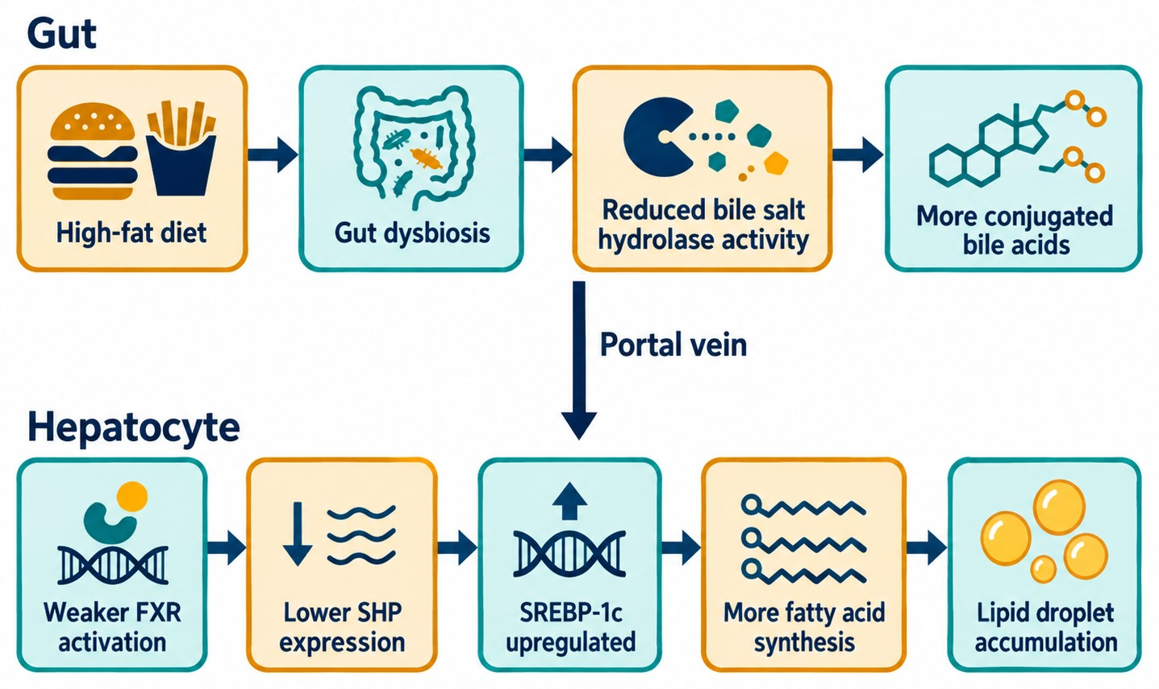
Restoring FXR signaling partly reversed liver fat build-up
03 Results · Aim 3 (Chapter 4)
FXR agonist
SHP recovered, SREBP-1c fell, and liver triglycerides dropped by about 32%.
Fecal microbiota transplant
Chow-fed recipients of HFD microbiota showed the same bile acid shift.
Conclusion
The microbiota–bile acid–FXR axis is a key link from diet to fatty liver.
Figure 4.5 Proposed model of the microbiota–bile acid–FXR axis in hepatic lipid metabolism
✦ Draw a matching mechanism figure; the prompt is pre-filled. Open SciDraw AI →
Notes:
This slide (1.5 minutes): first say what each experiment showed, then use the model on the left to tie all results into one chain.
Likely question: "Which parts of this model did you test, and which are inferred?" Be ready to point to the arrows you have data for.
Figure prompt: the example figure was generated from the prompt below. The link under the figure fills it in; or copy it and swap in your pathway and molecules:
Draw a mechanism model figure, flat vector style, white background, navy blue, teal and amber. The image has two parts, top and bottom. Top part, labeled "Gut": "High-fat diet" → "Gut dysbiosis" → "Reduced bile salt hydrolase activity" → "More conjugated bile acids". Bottom part, labeled "Hepatocyte": "Weaker FXR activation" → "Lower SHP expression" → "SREBP-1c upregulated" → "More fatty acid synthesis" → "Lipid droplet accumulation". Connect the two parts with one downward arrow labeled "Portal vein". All arrows are navy blue and mean "promotes / leads to"; do not use inhibition symbols and do not draw a legend. Each label appears only once, in English; no title in the image.
SciDraw AI research templates · sci-draw.com · Example edition: the study, names and data are fictional and only show what to write on each slide.

Slide 15
Summary: each aim has an answer
03 Results
Aim | Main finding | Key evidence | Chapter
Aim 1 | A high-fat diet changes the gut microbiota and the bile acid profile | 16S rRNA sequencing, bile acid metabolomics | 2, 3
Aim 2 | More conjugated bile acids go with weaker hepatic FXR–SHP signaling | qPCR, western blot, correlation analysis | 3
Aim 3 | FXR agonist and fecal transplant confirm a causal role | Intervention, fecal microbiota transplant | 4
In one line Dysbiosis → more conjugated bile acids → weaker hepatic FXR → more lipid synthesis.
Notes:
This slide (30 seconds): close the results with this table so the committee sees evidence for every aim.
SciDraw AI research templates · sci-draw.com · Example edition: the study, names and data are fictional and only show what to write on each slide.

Slide 16
Contributions & Conclusions
04
What this work adds, its limitations, and what comes next
Notes:
This slide: a transition.
SciDraw AI research templates · sci-draw.com · Example edition: the study, names and data are fictional and only show what to write on each slide.

Slide 17
Contributions to the field
04 Contributions & conclusions
01
02
03
Conceptual
Methodological
Translational
Tests the full microbiota–bile acid–FXR chain behind diet-induced fatty liver, not one link in isolation.
Combines 16S sequencing, targeted bile acid metabolomics and fecal transplant to move from association to causation.
Points to hepatic FXR signaling as a potential target for diet-related fatty liver.
Notes:
This slide (1 minute) is where the committee listens hardest: a dissertation must make an original contribution. For each point, say "previous work did X; this work adds Y."
Tip: keep each contribution specific and backed by a chapter. Avoid "first-ever" or "novel" claims you cannot defend under questioning.
SciDraw AI research templates · sci-draw.com · Example edition: the study, names and data are fictional and only show what to write on each slide.

Slide 18
Conclusions and future directions
04 Contributions & conclusions
Conclusions
Limitations & future work
1. A high-fat diet induces gut dysbiosis and alters the bile acid profile.
2. A higher share of conjugated bile acids goes with weaker hepatic FXR–SHP signaling.
3. Restoring FXR signaling partly reverses diet-induced liver fat accumulation.
Male mice only; sex differences remain to be tested.
Not yet validated in human samples.
The responsible bacterial strains are not identified.
Next: a clinical cohort and single-strain colonization in germ-free mice.
Notes:
This slide (45 seconds): read each conclusion, and name the limitations yourself. The committee will raise them anyway; raising them first shows command of your work.
Likely question: "If you had one more year, what would you do?" Your future-work line is the answer.
SciDraw AI research templates · sci-draw.com · Example edition: the study, names and data are fictional and only show what to write on each slide.

Slide 19
Publications and presentations
05 Publications
Type | Item | Status
Journal article | Doe J, Smith A. Article title. Journal Name. 2026;12(3):45–56. (Chapter 2) | Published
Journal article | Doe J*, Lee K*, Smith A. Article title. Journal Name. (*co-first authors; Chapter 3) | In revision
Journal article | Doe J, Garcia D, Smith A. Article title. (Chapter 4) | In preparation
Presentation | Annual meeting of a national society, poster | 2025
Funding | Predoctoral fellowship (Award No. XXXXXXX) | 2024–2026
Notes:
This slide (20 seconds): no need to read it out. Mark which chapter each paper corresponds to; committees check that each aim has a paper or a manuscript in progress.
SciDraw AI research templates · sci-draw.com · Example edition: the study, names and data are fictional and only show what to write on each slide.

Slide 20
Acknowledgments
Acknowledgments
Advisor
Committee
Prof. Alex Smith, for guidance on every step from the first experiment to the last chapter.
Prof. Jones, Prof. Patel and Dr. Garcia, for their time, questions and advice.
Lab, friends & family
Funding
The Smith Lab, our collaborators and the animal facility staff, and my family for their support.
This work was supported by [funding agency] (Award No. XXXXXXX).
Notes:
This slide (30 seconds): sincere and brief. A lab photo works well here: delete one card and insert the picture.
Tip: friends and family often attend the public part of a defense; this is the moment to thank them.
SciDraw AI research templates · sci-draw.com · Example edition: the study, names and data are fictional and only show what to write on each slide.

Slide 21
Thank you! Questions?
Jane Doe | Advisor: Prof. Alex Smith
Notes:
This slide: stay here during questions. To jump to a backup slide, type its number and press Enter during the Slide Show.
What usually happens next: questions from the audience, then a closed session with the committee, who then deliberate and tell you the outcome (often a pass with minor revisions). Repeat each question before you answer it.
SciDraw AI research templates · sci-draw.com · Example edition: the study, names and data are fictional and only show what to write on each slide.

Slide 22
Anticipated questions and answers
Backup · hidden in Slide Show; call up by slide number
Possible question | Key points of the answer | Evidence
Why FXR and not TGR5? | FXR is highly expressed in the liver and directly controls SHP–SREBP-1c; TGR5 is future work. | Slide 14; Fig. 3.6
How did the transplant rule out the diet itself? | All recipients ate chow, and a control group received microbiota from control donors. | Section 4.2
Is n = 10 per group enough? | A power analysis based on pilot effect sizes gave power above 80%. | Table S1
Why only male mice? | To avoid estrous-cycle effects on bile acid metabolism; listed as a limitation. | Slide 18
Notes:
This slide is hidden in Slide Show. Write down the questions you expect, so you know which slide to jump to.
How to hide a slide: right-click its thumbnail → Hide Slide. During the Slide Show, type the slide number and press Enter to jump to it.
SciDraw AI research templates · sci-draw.com · Example edition: the study, names and data are fictional and only show what to write on each slide.

Slide 23
Supplementary data: genus-level differences
Backup · supplementary data
Put data here that the committee may ask about but that did not fit in the talk.
For example: genus-level taxa, extra statistics, raw images.
Figure S1 [Caption]
✦ Need a figure? Describe it and draw it in SciDraw AI. Open SciDraw AI →
Notes:
This backup slide is hidden. Click the icon in the frame to insert your own figure.
SciDraw AI research templates · sci-draw.com · Example edition: the study, names and data are fictional and only show what to write on each slide.

