Slide 1
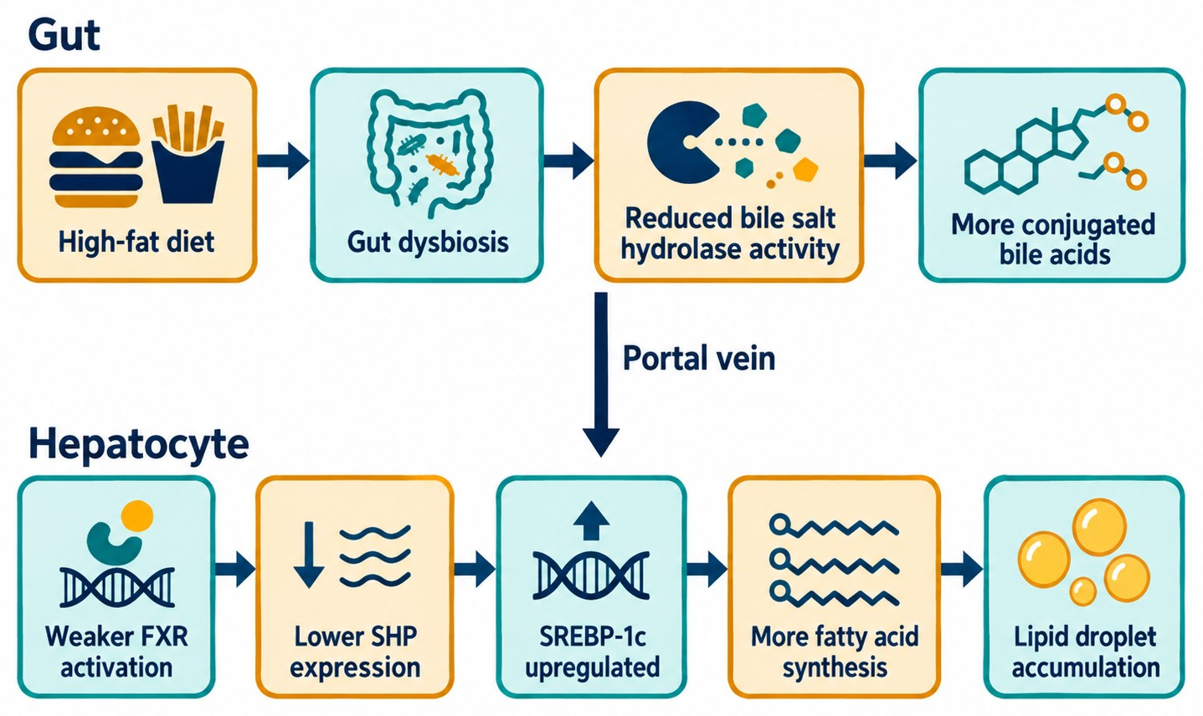
High-Fat Diet–Induced Gut Dysbiosis Promotes Hepatic Lipid Accumulation via the Bile Acid–FXR Axis
Logo
Logo
Jane Doe¹, Kim Lee¹, Alex Smith²*
¹ Dept. of Nutritional Sciences, Example University ² Example Medical Center *Contact: name@university.edu
Key finding
A high-fat diet drives liver fat via the microbiota–bile acid–FXR axis; restoring FXR cut liver triglycerides by ~32%.
Result 1: Liver fat rises
Result 2: Microbiota shift
Result 3: Bile acid shift
Figure 3 Liver triglycerides (example data, mean ± SD)
Figure 4 Phylum-level composition (example data)
Figure 5 Serum conjugated bile acids (example data, mean ± SD)
Background
Discussion
References
Fatty liver is tied to high-fat diets. Gut microbes reshape bile acids that reach the liver, but causality is unclear.
Fecal transplant reproduced the phenotype: the microbiota change is a cause, not a side effect.
1. Author AA, Author BB. Title of the article. Journal Name. Year;Vol(Issue):pages.
2. Author AA, Author BB. Title of the article. Journal Name. Year;Vol(Issue):pages.
3. Author AA, Author BB. Title of the article. Journal Name. Year;Vol(Issue):pages.
Objective
Does gut dysbiosis promote liver fat through bile acid–FXR signaling?
Conclusions
1. A high-fat diet induces dysbiosis and alters bile acids.
2. More conjugated bile acids suppress hepatic FXR signaling.
3. Restoring FXR partly reverses liver fat build-up.
Acknowledgments & contact
Insert QR code: paper / lab website
Methods
Design Control, HFD, or HFD + FXR agonist (n = 10, 12 weeks); fecal transplant.
Measures 16S sequencing, bile acid metabolomics, liver fat, FXR pathway.
Supported by [funding agency] (Award No. XXXXXXX). Contact: name@university.edu
SciDraw AI research poster template · sci-draw.com | Example edition: the study and data are fictional and only show the layout
Notes:
SciDraw AI research poster template · results spotlight · A0 portrait (841 × 1189 mm) · Navy palette
Example edition: the study and data are fictional. Slide 2 is a how-to page; print slide 1 only.

Slide 2
How to use this poster (this page does not print)
Size
This file: A0 portrait (841 × 1189 mm). Other files: 36 × 48 in portrait, 48 × 36 in landscape, A0 portrait (841 × 1189 mm), A0 landscape (1189 × 841 mm), A1 portrait (594 × 841 mm), A1 landscape (841 × 594 mm), 72 × 48 in landscape, 72 × 36 in landscape, 90 × 120 cm portrait. Download the size you need; scaling the page throws the type sizes out of proportion.
Type sizes
Title about 88 pt, section headings about 40 pt, body about 32 pt, captions about 24 pt: body text reads from 1–2 m (4–6 ft) away.
Colors
Every color is a theme color: Design → Variants → Colors recolors the whole poster. Or download a file in another preset palette.
Replace the content
The study and data are fictional examples. Charts and tables are native PowerPoint objects: right-click a chart → Edit Data.
Pictures
Right-click an example figure → Change Picture. For dashed frames, delete the frame and insert your flow chart or QR code.
Printing
File → Export as PDF and print slide 1 only. Tell the print shop the finished size.
Prompts for the example figures (the link opens SciDraw AI with the prompt filled in)
Background schematic Open SciDraw AI →
Draw a research background schematic of the gut–liver axis, flat vector style, white background, navy blue and teal as the main colors with a few amber accents. Four steps from left to right, connected by arrows: (1) "High-fat diet"; (2) "Gut dysbiosis", showing fewer beneficial bacteria and more opportunistic bacteria; (3) "Altered bile acids"; (4) "Portal vein" leading into the liver, where lipid droplets build up inside hepatocytes, labeled "Hepatic lipid accumulation". Draw the intestine and its microbes on the left, and the liver with one enlarged hepatocyte on the right. No title in the image; use only these five short English labels, in a large, legible font.
Mechanism model Open SciDraw AI →
Draw a mechanism model figure, flat vector style, white background, navy blue, teal and amber. The image has two parts, top and bottom. Top part, labeled "Gut": "High-fat diet" → "Gut dysbiosis" → "Reduced bile salt hydrolase activity" → "More conjugated bile acids". Bottom part, labeled "Hepatocyte": "Weaker FXR activation" → "Lower SHP expression" → "SREBP-1c upregulated" → "More fatty acid synthesis" → "Lipid droplet accumulation". Connect the two parts with one downward arrow labeled "Portal vein". All arrows are navy blue and mean "promotes / leads to"; do not use inhibition symbols and do not draw a legend. Each label appears only once, in English; no title in the image.

