Slide 1
Sleep deprivation impairs memory consolidation via microglial synapse engulfment
Journal Club
Paper Example A, et al. Journal Name. 2026 (fictional example paper)
Presenter Jane Doe Date September 22, 2026
Notes:
This slide (20 seconds): give the title, journal and year, and say where the authors are based if it helps put the work in context.
Tip: send the paper to the group a few days ahead so people come having read it.
SciDraw AI research templates · sci-draw.com · Example edition: the paper is fictional and only shows what to write on each slide.

Slide 2
Using this template for journal club
How to use · hidden in Slide Show
1 Time and length
2 The paper's figures
Plan 20–30 minutes and 12–16 slides, with half the time on the figures. Do not read the abstract aloud.
Replace the placeholder charts with screenshots of the figures and credit the source. Never redraw them as your own.
3 Critique, not summary
4 Bring it home
The evidence and strengths-and-limitations slides make the talk: which claims are well supported, which are speculation?
End with what the paper means for our work and a few discussion questions, so the discussion has a starting point.
Notes:
This slide explains the template. It is hidden in Slide Show; delete it when you are done.
SciDraw AI research templates · sci-draw.com · Example edition: the paper is fictional and only shows what to write on each slide.

Slide 3
The paper at a glance, and why I chose it
01 The paper
 | Details
Journal | Journal Name, 2026 (example)
Authors | Example A, et al.; Institute of Neuroscience, Example University
System | Mouse; hippocampal CA1
Methods | Sleep deprivation, synapse labeling and imaging, behavioral tests
Why this paper
1. It bears directly on our project on sleep and synaptic plasticity.
2. It proposes a testable cellular mechanism: microglia engulfing synapses.
3. Its synapse quantification could be used in our own experiments.
Notes:
This slide (1 minute): "Why this paper" matters most: it tells the group what angle to listen from.
SciDraw AI research templates · sci-draw.com · Example edition: the paper is fictional and only shows what to write on each slide.

Slide 4
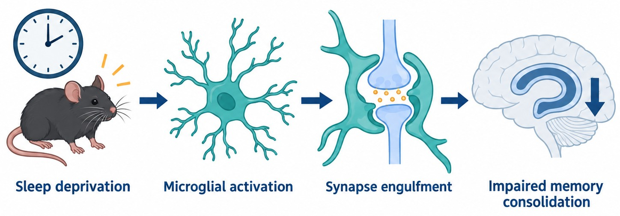
Background: why does sleep loss impair memory?
02 The question
What we know
Sleep deprivation weakens memory consolidation and lowers hippocampal synapse numbers.
What we don't
Are fewer synapses made, or are synapses actively removed? And by which cells?
The question
Does microglial engulfment of synapses cause the memory deficit after sleep loss?
Figure 1 The paper's hypothesis (drawn by the presenter, not from the paper)
✦ Sketch the paper's hypothesis in one figure; the prompt is pre-filled. Open SciDraw AI →
Notes:
This slide (1.5 minutes): three steps, what we know → what we don't → the question of this paper, to bring everyone into it.
Tip: label your own schematics "drawn by the presenter" so they are not mistaken for the paper's figures.
Figure prompt: the example figure was generated from the prompt below. The link under the figure fills it in:
Draw a research background schematic of the hypothesis that sleep deprivation impairs memory consolidation through microglial engulfment of synapses, flat vector style, white background, navy blue and teal with a few amber accents. Four steps from left to right, connected by navy arrows: (1) "Sleep deprivation", drawn as a clock and a wide-awake mouse; (2) "Microglial activation", drawn as a microglial cell extending its processes; (3) "Synapse engulfment", drawn as a microglial cell wrapping around a synapse; (4) "Impaired memory consolidation", drawn as a hippocampus outline with a downward arrow. Each label appears only once, in English; no title in the image.
SciDraw AI research templates · sci-draw.com · Example edition: the paper is fictional and only shows what to write on each slide.

Slide 5
Study design: from correlation to causation in three steps
02 The question
Observe
Figure 2
Block
Figure 3
Induce
Figure 4
After 6 h of sleep deprivation, hippocampal synapses drop and microglia hold more synaptic protein
Blocking microglial engulfment partly rescues both synapse loss and memory
Activating engulfment alone, without sleep loss, is enough to impair memory
Logic Show correlation, then necessity by blocking, then sufficiency by inducing.
Notes:
This slide (1 minute): lay out the logic of the whole paper. The figure-by-figure slides that follow fill in this map.
SciDraw AI research templates · sci-draw.com · Example edition: the paper is fictional and only shows what to write on each slide.

Slide 6
Sleep loss: fewer synapses, and microglia engulf more of them
03 Figure by figure · Figure 2
What is shown
Synapse density and synaptic protein in microglia, as % of control.
Key comparison
Synapses −22%; synaptic protein inside microglia +60%.
What it means
Loss and engulfment coincide, but this is only a correlation.
Evidence moderate (correlation)
Placeholder: replace with a screenshot of Figure 2 and credit it (Author, Journal, Year).
✦ Re-plot the paper's data in one consistent style in SciVis. Open in SciVis →
Notes:
This slide (2 minutes): read the figure in three steps on the right (what is shown → key comparison → what it means), then give the evidence rating.
Tip: the chart on the left only shows the layout. Replace it with a screenshot of Figure 2 and credit the source.
SciDraw AI research templates · sci-draw.com · Example edition: the paper is fictional and only shows what to write on each slide.

Slide 7
Blocking engulfment partly rescues memory
03 Figure by figure · Figure 3
What is shown
Accuracy of three groups of mice over 5 days of training.
Key comparison
Day 5: ~60% after sleep loss vs. ~78% with the blocker.
What it means
Engulfment is one necessary step in the memory deficit.
Evidence fairly strong (intervention)
Placeholder: replace with a screenshot of Figure 3 and credit it (Author, Journal, Year).
✦ Re-plot the paper's data in one consistent style in SciVis. Open in SciVis →
Notes:
This slide (2 minutes): the key figure of the paper. Stress "partly": other mechanisms must be involved too.
SciDraw AI research templates · sci-draw.com · Example edition: the paper is fictional and only shows what to write on each slide.

Slide 8
Activating engulfment alone also impairs memory
03 Figure by figure · Figure 4
What is shown
Normally sleeping mice given a drug that activates engulfment.
Key comparison
Synapses −19%; memory accuracy falls from 84% to 63%.
What it means
More engulfment is sufficient to impair memory.
Evidence fairly strong (off-target risk)
Placeholder: replace with a screenshot of Figure 4 and credit it (Author, Journal, Year).
✦ Re-plot the paper's data in one consistent style in SciVis. Open in SciVis →
Notes:
This slide (1.5 minutes): after the conclusion, raise the possibility of off-target drug effects yourself. It is a good opening for discussion.
SciDraw AI research templates · sci-draw.com · Example edition: the paper is fictional and only shows what to write on each slide.

Slide 9
Main claims and how strong the evidence is
04 Critique
Claim | Supporting evidence | Strength
Sleep loss reduces hippocampal synapses | Figure 2: synapse marker counts | ★★★
Microglial engulfment is necessary | Figure 3: blocking gives partial rescue | ★★☆
More engulfment is sufficient to impair memory | Figure 4: activating engulfment alone | ★★☆
The mechanism also applies to humans | Speculation in the Discussion; no data | ★☆☆
★★★ well supported ★★☆ strong, but alternative explanations remain ★☆☆ speculative, no direct evidence
Notes:
This slide (1.5 minutes): separate what the paper says from what the data show. This is the most valuable part of a journal club.
SciDraw AI research templates · sci-draw.com · Example edition: the paper is fictional and only shows what to write on each slide.

Slide 10
Strengths and limitations
04 Critique
Strengths
Limitations
Complete logic: correlation → necessity → sufficiency.
Careful synapse counts, using both pre- and postsynaptic markers.
Behavioral and cellular evidence agree.
Male mice only; sex differences unknown.
Blocker and activator may act off target; no genetic confirmation.
"Partial rescue" points to other mechanisms, which the paper barely discusses.
Notes:
This slide (1.5 minutes): limitations are not nitpicking. Frame each as "if we did this study, how would we close the gap?"
SciDraw AI research templates · sci-draw.com · Example edition: the paper is fictional and only shows what to write on each slide.

Slide 11
What this means for our work
05 Implications & discussion
01
02
03
A method to borrow
An idea to test
A gap to fill
Co-localized pre- and postsynaptic counts, directly usable in our sleep fragmentation model.
Measure microglial engulfment in our model and see whether the same change appears.
Use microglia-specific knockout mice instead of drugs to rule out off-target effects.
Notes:
This slide (1.5 minutes): this turns the talk from "someone else's work" into "how it moves our project forward".
SciDraw AI research templates · sci-draw.com · Example edition: the paper is fictional and only shows what to write on each slide.

Slide 12
Questions for discussion
05 Implications & discussion
Q1
What else could explain the "partial rescue"? Could we tell the mechanisms apart?
Q2
How likely are off-target drug effects? How would we design the genetic experiment?
Q3
Would the same mechanism hold under chronic sleep restriction?
Notes:
This slide: stay here and lead the discussion. Make the questions specific and answerable, ideally tied to our own projects.
SciDraw AI research templates · sci-draw.com · Example edition: the paper is fictional and only shows what to write on each slide.

Slide 13
Thank you. Let's discuss!
Example A, et al. Sleep deprivation impairs memory consolidation via microglial synapse engulfment. Journal Name. 2026.
Notes:
This slide: leave the full reference on screen so people can look the paper up afterward.
SciDraw AI research templates · sci-draw.com · Example edition: the paper is fictional and only shows what to write on each slide.

Slide 14
Supplementary material: extra figures and methods
Backup · hidden in Slide Show
Put supplementary figures or method details here that people may ask about.
For example: sleep deprivation protocol, statistics, sample sizes.
Figure S1 (supplementary figure from the paper; credit the source)
Notes:
This slide is hidden in Slide Show. Call it up by slide number when someone asks about the methods.
SciDraw AI research templates · sci-draw.com · Example edition: the paper is fictional and only shows what to write on each slide.

