Slide 1
A LiF-Rich Artificial Interphase Extends the Cycle Life of Lithium-Metal Anodes in Carbonate Electrolytes
Conference talk · Session X
Speaker Jane Doe, Prof. Alex Smith
Affiliation Department of Materials Science and Engineering, Example University
Meeting International Conference on Energy Storage Materials, 2026
Notes:
This slide (15 seconds): the session chair has usually introduced you already. Thank them, say the title, and move on.
Tip: a talk title can be shorter and plainer than the paper title, but it should name the key result or method.
SciDraw AI research templates · sci-draw.com · Example edition: the study and data are fictional and only show what to write on each slide.

Slide 2
Using this template for a conference talk
How to use · hidden in Slide Show
1 Mind the clock
2 One finding per slide
A contributed talk is usually 12–15 minutes plus 3 for questions, about 1 minute per slide. Past 14 slides, you will run over.
Write each result title as a finding. The body holds one figure and two or three numbers that support it.
3 Figures and charts
4 End with contact info
Click a frame icon to insert a picture; the link under a schematic opens a ready-made prompt. Charts: right-click → Edit Data.
Put your email and a QR code to the paper on the last slide. The backup slide is hidden; call it up by number.
Notes:
This slide explains the template. It is hidden in Slide Show; delete it when you are done.
SciDraw AI research templates · sci-draw.com · Example edition: the study and data are fictional and only show what to write on each slide.

Slide 3
Overview and take-home message
OVERVIEW
01
Motivation
Take-home message
A LiF-rich interphase, built on the lithium surface before cycling, roughly doubles cycle life in a carbonate electrolyte.
The audience will remember one sentence. Say it now.
Why lithium metal, and what fails
02
Approach & methods
Building a LiF-rich interphase
03
Results
Deposition · cycling · mechanism
04
Conclusions & outlook
Scope and next steps
Notes:
This slide (30 seconds): give the conclusion first and the story second. Attention is highest in the first minute, which is the biggest difference between a conference talk and a defense.
SciDraw AI research templates · sci-draw.com · Example edition: the study and data are fictional and only show what to write on each slide.

Slide 4
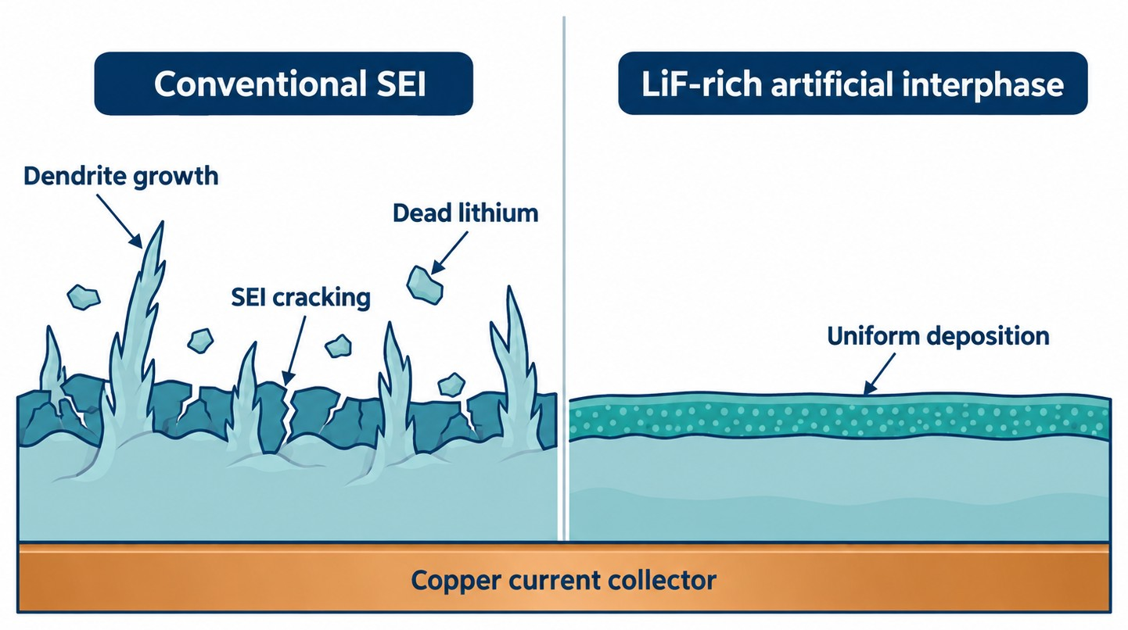
Lithium metal: highest capacity, but a short life
01 Motivation
Why lithium metal
Theoretical capacity of 3860 mAh/g, about 10× that of graphite: the key to high-energy cells.
What goes wrong
A non-uniform native SEI cracks again and again, feeding dendrites and "dead" lithium.
Our idea
Replace the unstable native SEI with a dense, uniform LiF-rich artificial interphase.
Figure 1 Li deposition: conventional SEI vs. LiF-rich artificial interphase (schematic)
✦ Make a matching schematic in SciDraw AI; the prompt is pre-filled. Open SciDraw AI →
Notes:
This slide (1 minute): three sentences: why it matters → what goes wrong → our idea. The figure on the right makes the contrast obvious.
Figure prompt: the example figure was generated from the prompt below. The link under the figure fills it in; swap in your own system:
Draw a comparison schematic of the lithium-metal anode problem, flat vector style, white background, navy blue and teal with a few amber accents. Two panels side by side. Left panel, labeled "Conventional SEI": a cracked SEI film on the lithium surface, lithium dendrites growing upward, and broken-off pieces of isolated lithium, with the labels "Dendrite growth", "SEI cracking" and "Dead lithium". Right panel, labeled "LiF-rich artificial interphase": one dense, uniform interphase layer with lithium deposited evenly and compactly beneath it, labeled "Uniform deposition". A single copper current collector runs along the bottom of both panels, labeled once as "Copper current collector". Each label appears only once, in English; no title in the image.
SciDraw AI research templates · sci-draw.com · Example edition: the study and data are fictional and only show what to write on each slide.

Slide 5
Current strategies trade one problem for another
01 Motivation
Strategy | Strength | Limitation
Electrolyte additives | Simple and easy to scale | Consumed over cycling; fade in long-term tests
PVD / CVD artificial SEI | Dense, well-controlled layers | Costly equipment; hard to coat large areas
3D current collectors | Lower local current density | Extra inactive mass lowers energy density
Our angle Grow a LiF-rich layer in situ by dipping lithium in a solution at room temperature: simple, and compatible with commercial carbonate electrolytes.
Notes:
This slide (45 seconds): skip the full field review. Name the two or three approaches closest to yours and the gap they leave.
Tip: to cite specific work, add "Author, year" to the table and put full references on a backup slide.
SciDraw AI research templates · sci-draw.com · Example edition: the study and data are fictional and only show what to write on each slide.

Slide 6
Approach: build → observe → test → explain
02 Approach & methods
Build
Observe
Test
Explain
Interphase
Deposition
Cycling
Mechanism
Dip Li foil in a fluorinated precursor to grow a LiF-rich layer
Nucleation overpotential and deposit morphology
Long-term symmetric and full-cell cycling
XPS depth profiling and ionic conductivity
✦ These are editable shapes: just type over them. Want a picture version? The prompt is pre-filled. Open SciDraw AI →
Notes:
This slide (30 seconds): tell the audience which question each of the next slides answers. The result slides follow this order.
SciDraw AI research templates · sci-draw.com · Example edition: the study and data are fictional and only show what to write on each slide.

Slide 7
Methods
02 Approach & methods
Interphase synthesis
  Li foil dipped in a fluorinated precursor (example: 25 °C, 10 min)
  Rinsed with solvent and dried
  All steps in an argon-filled glovebox
Characterization
  SEM: deposit morphology and layer thickness
  XPS depth profiling: layer composition
  EIS: interfacial ionic conductivity
Electrochemistry
  Li||Cu cells: nucleation overpotential, Coulombic efficiency
  Li||Li symmetric cells: 1 mA/cm², 1 mAh/cm²
  Li||LFP full cells: long-term cycling at 1C
Notes:
This slide (45 seconds): give only the conditions the audience needs to read the results. Full parameters go in the paper or on a backup slide.
SciDraw AI research templates · sci-draw.com · Example edition: the study and data are fictional and only show what to write on each slide.

Slide 8
The interphase cuts nucleation overpotential by ~40%
03 Results · Deposition
Deposit morphology (SEM)
Insert SEM image
Bare Cu
Insert SEM image
LiF-rich interphase
Dense, chunky lithium on the interphase; clear dendrites on bare Cu.
Figure 2 Li||Cu overpotential at 0.5 mA/cm² (example data, mean ± SD, n = 3)
✦ Right-click → Edit Data, or re-plot your raw data in SciVis. Open in SciVis →
Notes:
This slide (1 minute): read the finding in the title, point to the numbers on the left, then let the SEM images show the difference.
Tip: SEM, TEM and other experimental images must be your own raw images, never AI-generated. The two frames on the right are placeholders; delete them and insert your images.
SciDraw AI research templates · sci-draw.com · Example edition: the study and data are fictional and only show what to write on each slide.

Slide 9
Full cells keep 86% capacity after 500 cycles, vs. 41%
03 Results · Cycling
86%
Retention after 500 cycles
99.3%
Average Coulombic efficiency
~2×
Longer cycle life
Figure 3 Li||LFP full-cell cycling at 1C (example data)
✦ Right-click → Edit Data, or upload your cycling data to SciVis. Open in SciVis →
Notes:
This slide (1 minute) is your most important figure. Say what the two lines are, then stop on the comparison at 500 cycles.
Tip: the three numbers on the right are what people will remember; make sure they match the chart and your text.
SciDraw AI research templates · sci-draw.com · Example edition: the study and data are fictional and only show what to write on each slide.

Slide 10
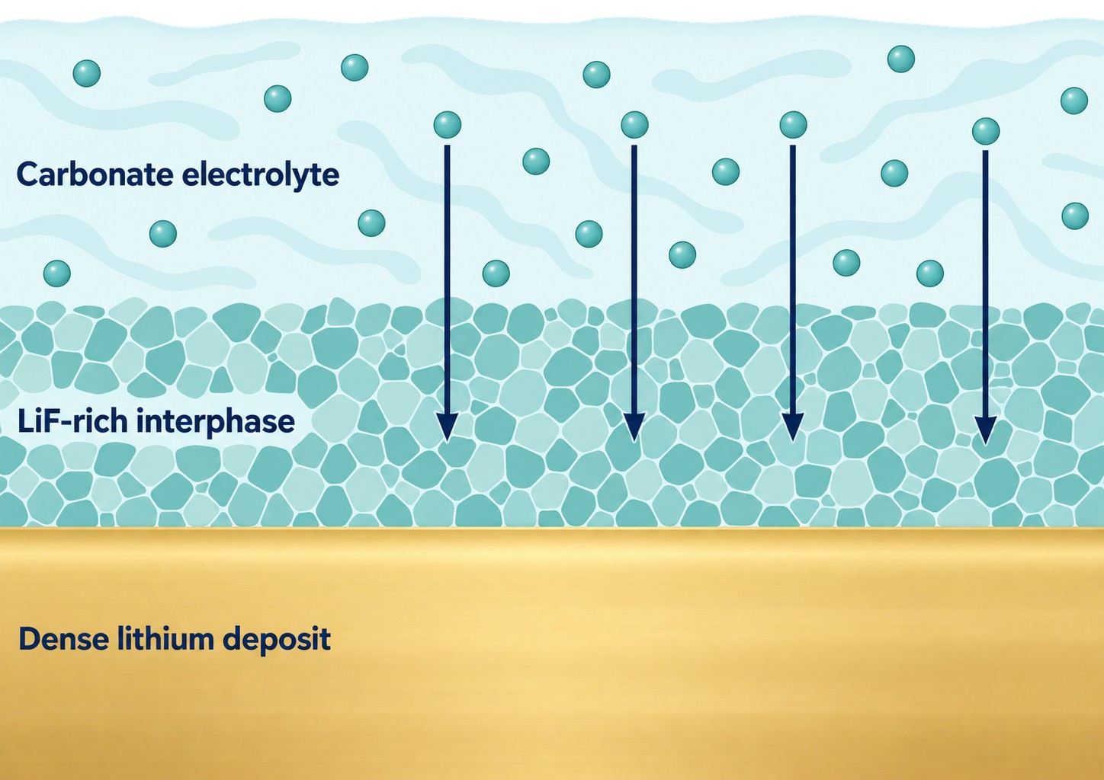
The interphase evens out Li⁺ flux and blocks side reactions
03 Results · Mechanism
Composition
XPS depth profiling shows a LiF-dominated layer about 50 nm thick.
Ion transport
Higher interfacial ionic conductivity gives a more uniform Li⁺ flux.
Stability
The layer suppresses ongoing electrolyte decomposition; impedance grows more slowly.
Figure 4 How a LiF-rich interphase stabilizes the lithium-metal anode (schematic)
✦ Draw a matching mechanism figure; the prompt is pre-filled. Open SciDraw AI →
Notes:
This slide (1 minute): use the schematic to explain why the previous two results happen.
Figure prompt: the example figure was generated from the prompt below. The link under the figure fills it in:
Draw a mechanism schematic showing how a LiF-rich artificial interphase stabilizes a lithium-metal anode, flat vector style, white background, navy blue, teal and amber. Three horizontal layers from top to bottom, filling the full width of the image: the top layer is "Carbonate electrolyte", with lithium ions drawn as small plain circles without any text; the middle layer is "LiF-rich interphase", drawn as a dense layer of grains that the lithium ions cross as evenly spaced, parallel navy arrows pointing down; the bottom layer is "Dense lithium deposit". Use only these three English labels, each appearing once, placed at the left of its layer. No legend, no numbered notes, no other text, and no title in the image.
SciDraw AI research templates · sci-draw.com · Example edition: the study and data are fictional and only show what to write on each slide.

Slide 11
Versus other strategies: simple and carbonate-compatible
04 Conclusions & outlook
Strategy | Processing effort | Works in carbonates | Scalability
Electrolyte additives | Low | Partly | High
Vapor-deposited artificial SEI | High | Yes | Low
This work: solution dipping | Low | Yes | Fairly high
Note This qualitative comparison only shows the layout. In your talk, compare quantitative metrics under matched conditions and cite the sources.
Notes:
This slide (30–45 seconds): someone will ask "how does this compare with X?" A comparison table answers it before they do.
Tip: compare only at matched current density, areal capacity and electrolyte; otherwise the numbers are not comparable.
SciDraw AI research templates · sci-draw.com · Example edition: the study and data are fictional and only show what to write on each slide.

Slide 12
Conclusions and outlook
04 Conclusions & outlook
Conclusions
Limitations & next steps
1. Solution dipping grows a LiF-rich interphase on lithium.
2. The interphase cuts nucleation overpotential by ~40%, giving denser deposits.
3. Full-cell retention at 500 cycles rises from 41% to 86%.
Stability at high areal capacity (> 3 mAh/cm²) is untested.
How the layer evolves at high temperature is unclear.
Next: pouch cells and operando characterization.
Take-home A LiF-rich interphase roughly doubles the cycle life of lithium-metal anodes.
Notes:
This slide (45 seconds): read the conclusions, then end on the same sentence you opened with.
SciDraw AI research templates · sci-draw.com · Example edition: the study and data are fictional and only show what to write on each slide.

Slide 13
Acknowledgments
Acknowledgments
Advisor
Collaborators
Prof. Alex Smith, for guidance and support.
The Jones group, for help with XPS measurements.
Facilities
Funding
The Example University shared materials characterization facility.
[Funding agency] (Award No. XXXXXXX).
Notes:
This slide (15 seconds): move through it quickly. Funding agency logos can replace the text cards if you prefer.
SciDraw AI research templates · sci-draw.com · Example edition: the study and data are fictional and only show what to write on each slide.

Slide 14
Thank you! Questions?
Speaker Jane Doe · Example University
Email name@university.edu
Paper Journal Name, 2026 (scan the QR code)
Paper / lab website
Notes:
This slide: stay here during questions. Click the icon on the right to insert a QR code for the paper or your lab website.
Tip: repeat each question into the microphone before answering, so the whole room hears it.
SciDraw AI research templates · sci-draw.com · Example edition: the study and data are fictional and only show what to write on each slide.

Slide 15
Likely questions and answers
Backup · hidden in Slide Show; call up by slide number
Possible question | Key points of the answer | Evidence
How do you control layer thickness? | By dipping time: 10 min gives ~50 nm; longer times raise impedance sharply. | Fig. S2
Does it work at high areal capacity? | Stable up to 3 mAh/cm²; higher loadings are the next step. | Slide 12
How does it compare with an FEC additive? | The two can be combined, and their effects are complementary. | Fig. S5
Notes:
This slide is hidden in Slide Show. During questions, type its number and press Enter to jump to it.
SciDraw AI research templates · sci-draw.com · Example edition: the study and data are fictional and only show what to write on each slide.

